Slide 1

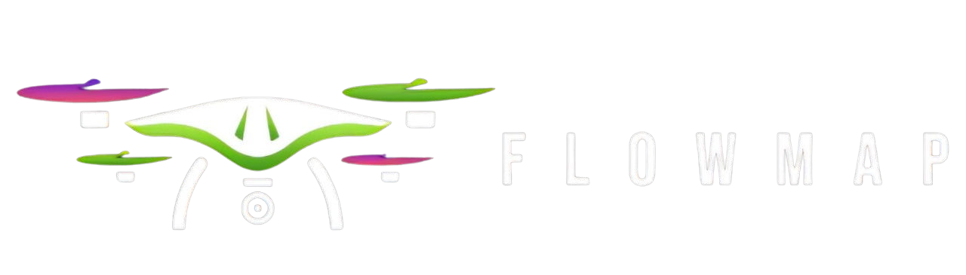
Aquatic Weeds Group 6

Slide 2



Problem Statement
Problem Description Problem Solution

Slide 3





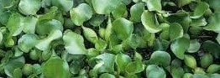
Hyacinth: A Problematic Species
The
is an invasive species that can disrupt ecosystems. Its rapid growth
can cause and economic issues. Understanding how to detect and predict its spread is crucial in managing its impact on local habitats and human activities.

Slide 4


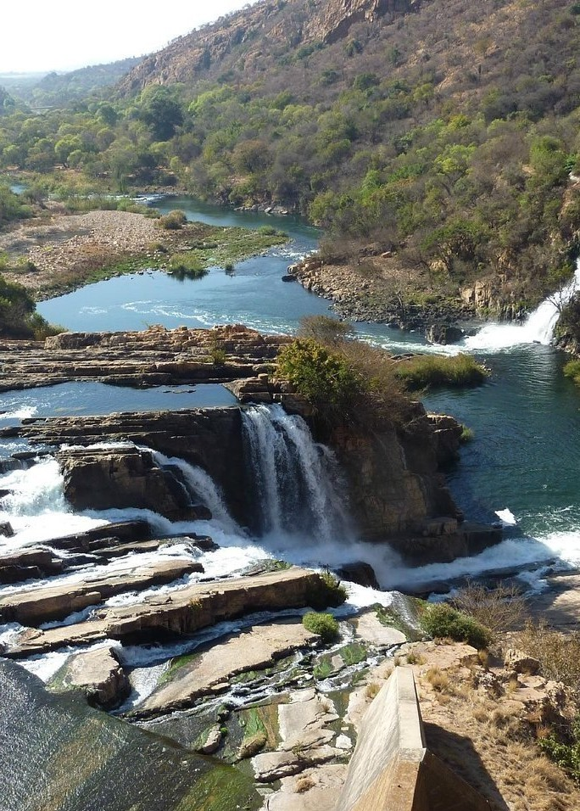

Importance of Object Detection
Object detection plays a vital role in
. It enables systems to identify and locate within images or videos. This capability
is essential for applications such as
, surveillance, and wildlife monitoring, leading to better decision-making.
Realtime implementation Prediction

Slide 5

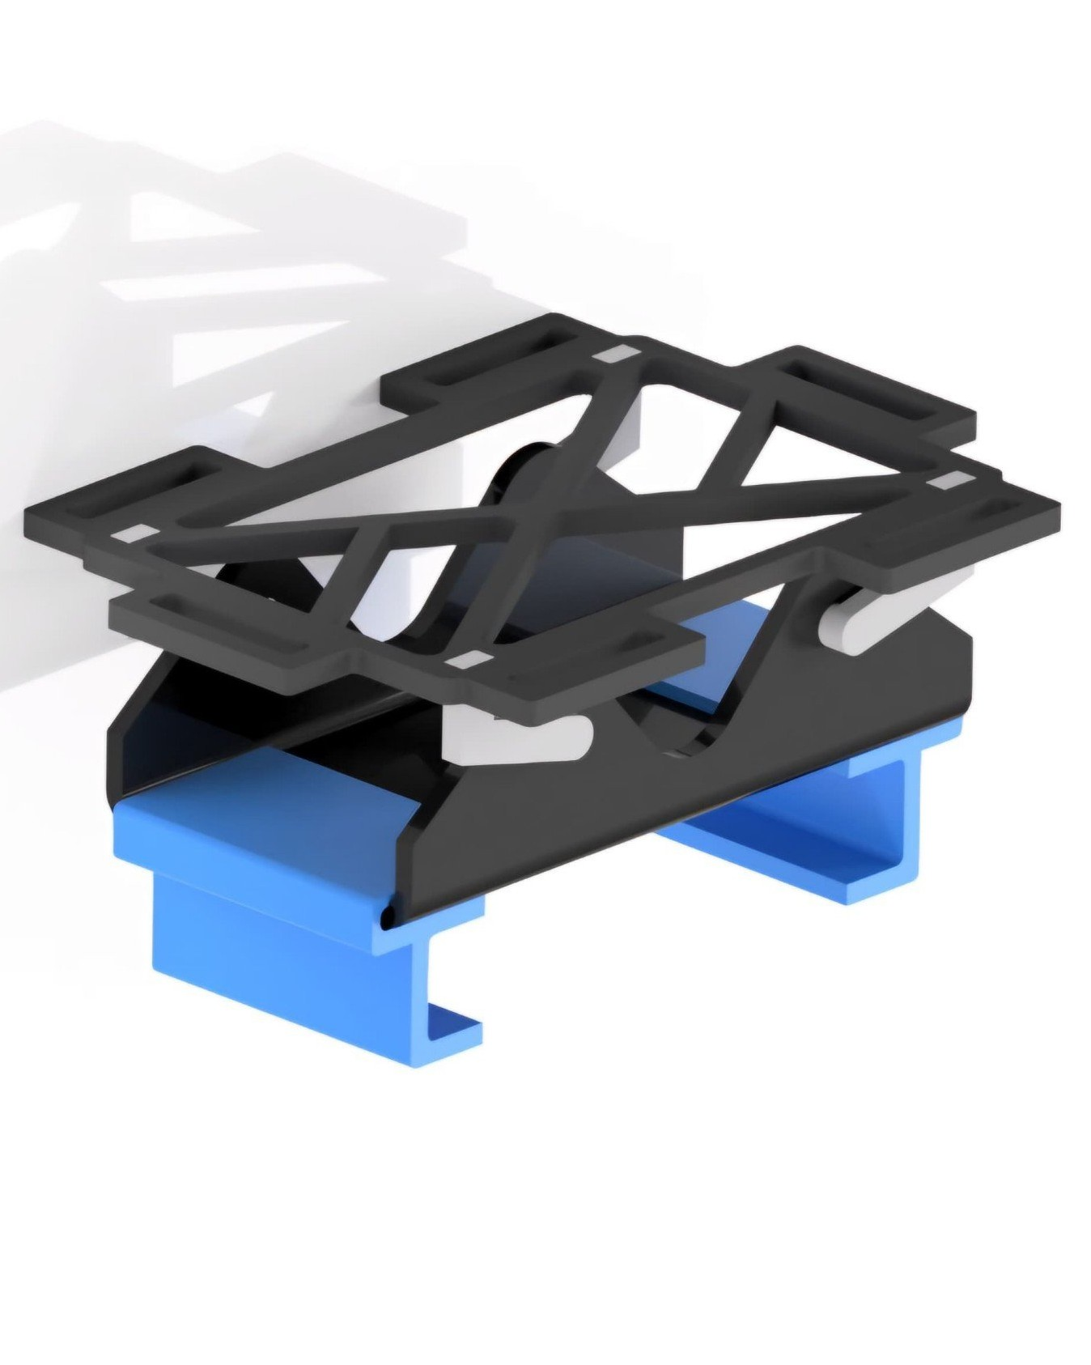
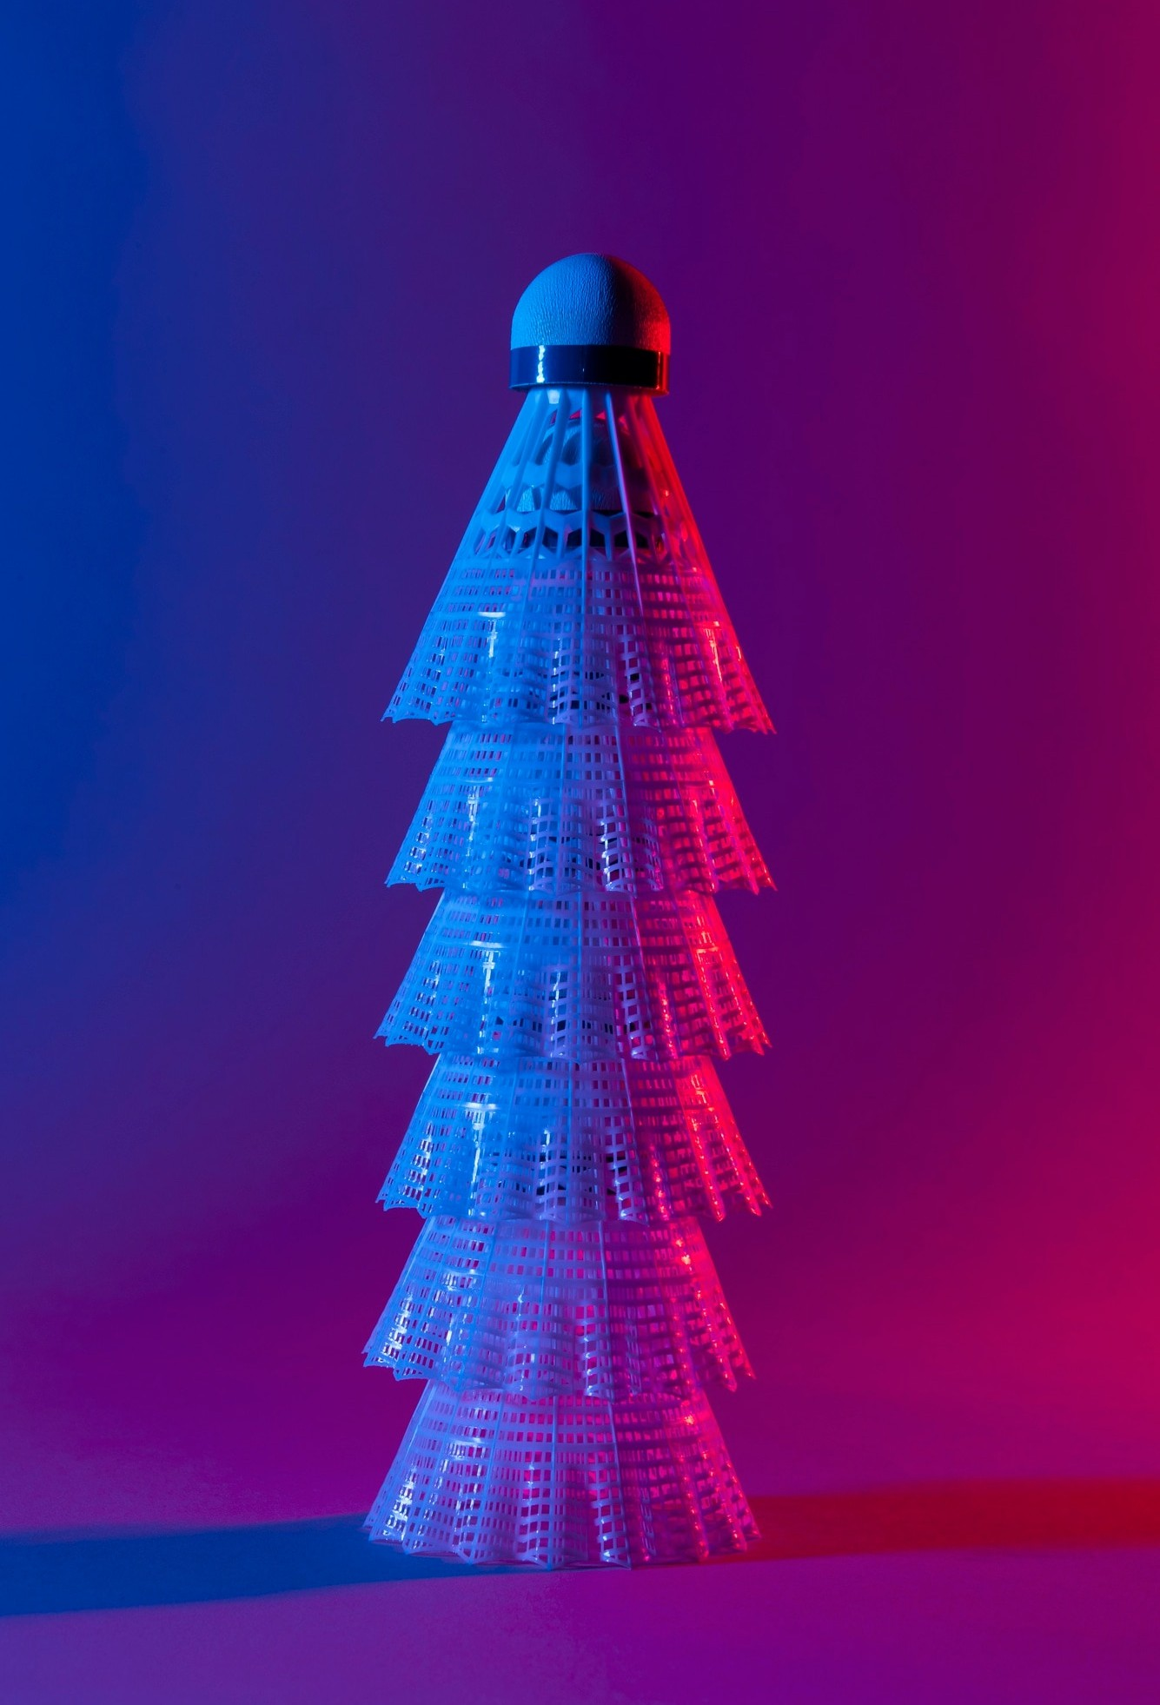
Universal Drone Mount
A Universal Drone mount that is designed to attach to any size drone, which you can strap the drone mount to the drone.
Ease-to-use, only redesign phone clips Universal
Quick Setup

Slide 6


Data Collection Methods
Linux Ubuntu Server PostgreSQL Database
A Linux Ubuntu server hosted on the local network, that can host, send and receive.
Then the database is hosted on PostgreSQL, which communicates between the user and the server.
Drone imagery

Slide 7

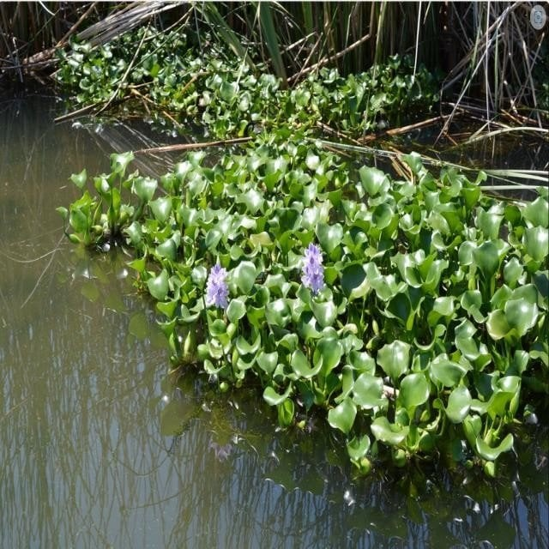
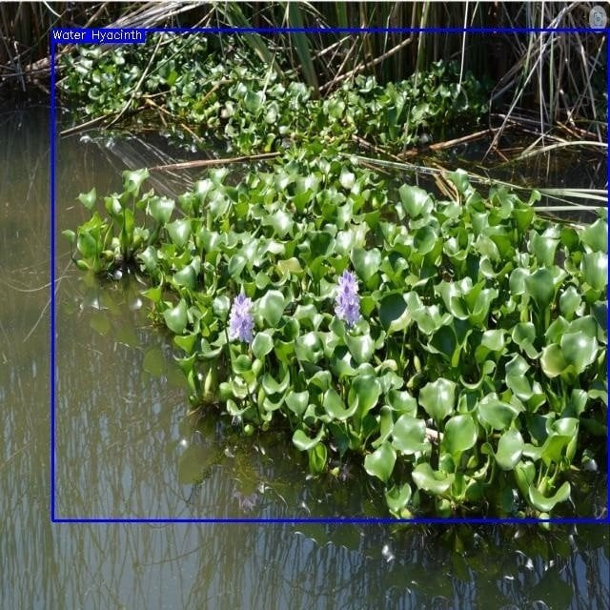

Model Training and Validation
Input:
Roboﬂow is a company which provides computer vision models which you can use or create your own.
Custom Hyacinth Detection Model
The model is trained on a large dataset of Hyacinth Images.
Therefore you can improve the model by adding new images and retraining the model.
Output:

Slide 8

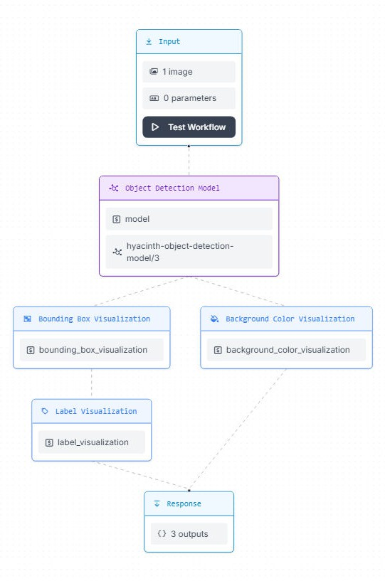
Obejct Detection Workflow
Workﬂow:
Takes images, then runs it through object detection model which uses Visualization methods to draw boxes around the Hyacinths, which is then labeled. After all this is done you are given a response of a image with the
detected Hyacinths.

Slide 9
Thanks!

